Slide 1


K.RAMAKRISHNAN COLLEGE OF TECHNOLOGY
(AUTONOMOUS), TRICHY.
NEWS PORTAL SYSTEM
PRESENTED
HARSHINI
2303811710422061
SUPERVISOR
Mr. M. Saravanan, M.E.,
AP/CSE.

Slide 2
PRESENTATION OVERVIEW
Objective
Project Introduction
Problem Statement
Methodologies (Programming concepts relevant to problem statement)
Architecture of the proposed system
List of Modules
Merits
Results and Discussion
Queries

Slide 3
OBJECTIVE
The objective of this project is to design and implement a user-friendly News Portal System using Java. The system aims to provide secure login functionality for both users and administrators, ensuring data protection and personalized access. Regular users can browse news articles categorized into various topics, while administrators can manage and add new content. By leveraging Java AWT for the graphical user interface, the project ensures an intuitive and interactive user experience.

Slide 4
PROJECT INTRODUCTION
The News Portal System is a Java-based application designed to provide users with an organized and interactive platform to access news articles. With a focus on simplicity and functionality, the system offers categorized news under topics like Sports, Technology, Entertainment, and Politics. It incorporates two types of users: regular users who can view articles and administrators who can manage content. The project leverages Java's AWT for its graphical interface and follows object-oriented principles for modularity and reusability. By combining secure login mechanisms and intuitive design, the News Portal aims to cater to both casual readers and administrators efficiently.

Slide 5
PROBLEM STATEMENT
In today's digital age, accessing relevant and organized news content can be challenging due to the overwhelming volume of information available online. Many platforms lack user-specific features, secure access, and efficient content management. This project addresses these issues by providing a user-friendly News Portal System with secure authentication, categorized news articles, and administrative tools for content management. The goal is to streamline the news-reading experience while ensuring robust functionality for both users and administrators.

Slide 6
METHODOLOGIES
The News Portal System uses Java's Object-Oriented Programming (OOP) principles, including encapsulation, inheritance, and polymorphism, to ensure a modular and efficient design. It leverages Java AWT for an interactive graphical user interface and event-driven programming to manage user interactions. Data structures like ArrayList and HashMap are utilized for organizing and retrieving user data and articles effectively. This combination of techniques provides a scalable and user-friendly application for managing news content.

Slide 7
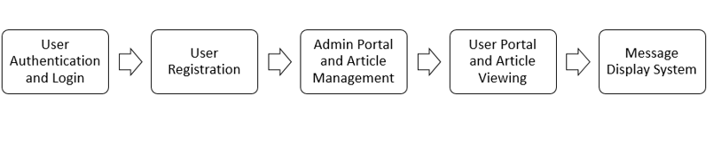
ARCHITECTURE OF THE PROPOSED SYSTEM

Slide 8
LIST OF MODULES
MODULE DESCRIPTON
User Authentication and Login: This module validates users' credentials during login, granting access based on user roles (admin or regular user). It ensures that only authorized users can access the portal.
User Registration: New users can sign up by entering a unique username and password. The system validates input to prevent special characters, ensuring proper registration.

Slide 9
LIST OF MODULES
MODULE DESCRIPTON
Admin Portal and Article Management: Admins can view, add, or manage articles across categories. This module helps in content control and article management within the portal.
User Portal and Article Viewing: Regular users can browse articles categorized by topics like sports, technology, and more. This module offers an interface for reading content without editing privileges.
Message Display System: This module displays feedback messages to users, confirming successful actions or errors. It ensures users are informed about the status of their actions.

Slide 10
MERITS
User-Friendly Interface: The system provides an intuitive and easy-to-use interface for both admins and regular users, ensuring smooth navigation and operation.
Efficient Article Management: Admins have full control over managing and categorizing articles, ensuring content is well-organized and up-to-date.
Secure Authentication: With a secure login and registration process, the system ensures that only authorized users can access sensitive areas, maintaining privacy and security.

Slide 11
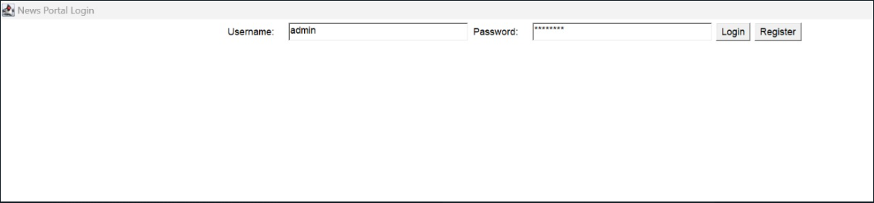
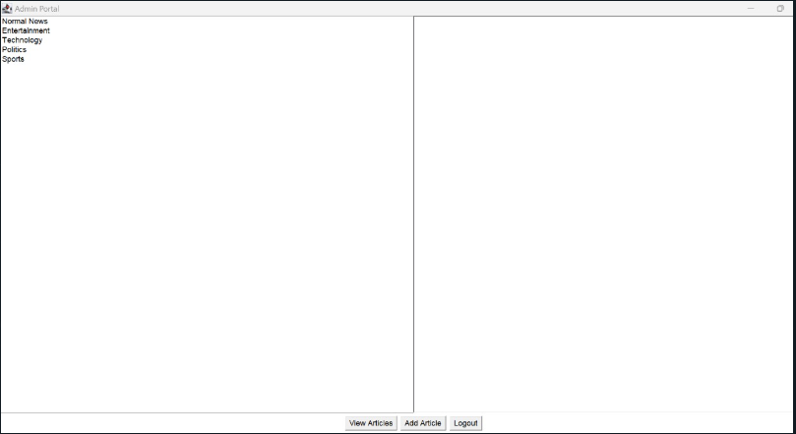
RESULTS AND DISCUSSION

Slide 12
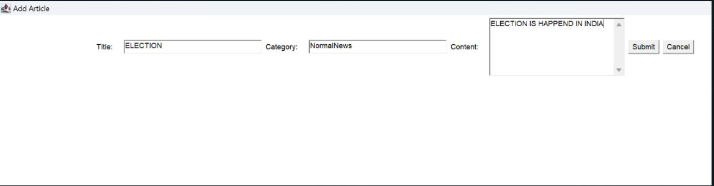
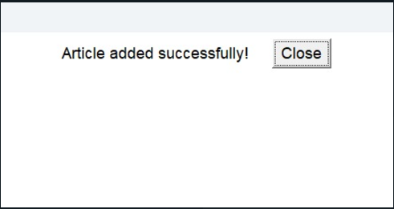
RESULTS AND DISCUSSION

Slide 13
QUERIES ?

